Slide 1
Final Project ML: Heart Failure Prediction
IBM Machine Learning Professional Certificate
Supervised Machine Learning: Classification
Shaula Marquez

Slide 2

Contents
Data Description
Main Objective
Data Analysis
Classification models
Analysis and Findings
Conclusion

Slide 3
Data Description
Supervised Machine Learning: Classification
Heart Failure Analysis Prediction

Slide 4
Introduction
Cardiovascular diseases (CVDs) are the number 1 cause of death globally, taking an estimated 17.9 million lives each year, which accounts for 31% of all deaths worldwide.
Heart failure is a common event caused by CVDs and this dataset contains 12 features that can be used to predict mortality by heart failure.
Most cardiovascular diseases can be prevented by addressing behavioral risk factors such as tobacco use, unhealthy diet and obesity, physical inactivity and harmful use of alcohol using population-wide strategies.
People with cardiovascular disease or who are at high cardiovascular risk (due to the presence of one or more risk factors such as hypertension, diabetes, hyperlipidemia or already established disease) need early detection and management wherein a machine learning model can be of great help.

Slide 5
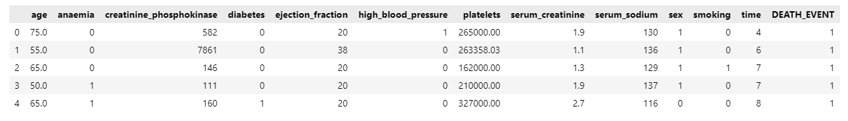
Dataset Description
Age: Age of the patient
Anemia: Hemoglobin level of patient (Boolean)
Creatinine Phosphokinase: Level of the CPK enzyme in the blood (mcg/L)
Diabetes: If the patient has diabetes (Boolean)
Ejection fraction: Percentage of blood leaving the heart at each contraction
High blood pressure: If the patient has hypertension (Boolean)
Platelets: Platelet count of blood (kilo platelets/mL)

Slide 6
Dataset Description
Serum creatinine: Level of serum creatinine in the blood (mg/dL)
Serum sodium: Level of serum sodium in the blood (mEq/L)
Sex: Sex of the patient
Smoking: If the patient smokes or not (Boolean)
Time: Follow-up period (days)
DEATH_EVENT: If the patient deceased during the follow-up period (Boolean)
Attributes having Boolean values:
0 = Negative (No); 1 = Positive (Yes)

Slide 7
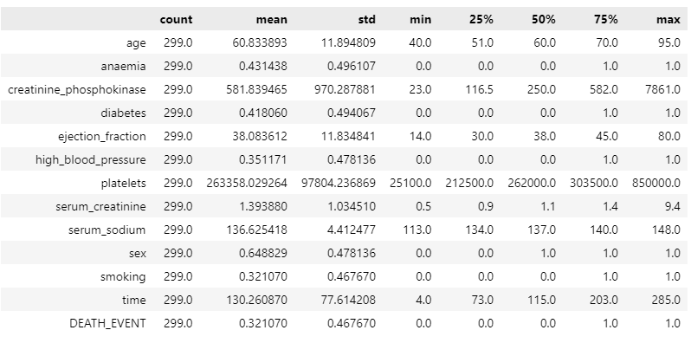
Dataset Description: Statistical

Slide 8
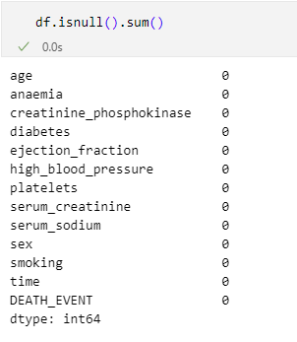

Dataset Description: Missing Values
There are no missing values.

Slide 9
Main Objective of the Analysis:
The primary objective of this analysis is to develop a predictive model that accurately identifies individuals at risk of heart failure based on key clinical and demographic features. By analyzing the correlation between different factors, we aim to determine the most influential predictors of heart failure.
To achieve this, we employ various machine learning classification models, leveraging techniques such as GridSearch, ML pipelines, and hyperparameter tuning to optimize performance. The goal is to select the most effective model in terms of accuracy while assessing the limitations of each approach. Ultimately, this analysis seeks to contribute to early detection and improved clinical decision-making for heart failure patients.

Slide 10
Data Analysis
Supervised Machine Learning: Classification
Heart Failure Analysis Prediction

Slide 11
Data Analysis: Identifying Features
We Identified the Categorical Features and Continous Features.

Slide 12
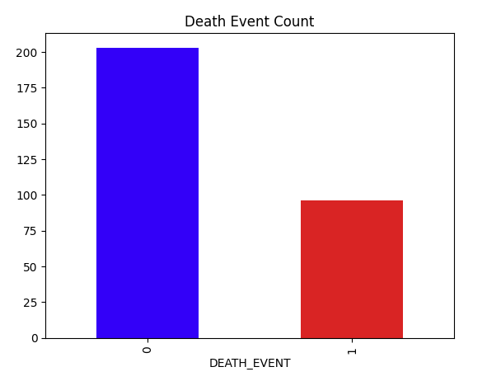

Data Analysis: Death Event Count
We have 96 people who died due to Heart Failure and 203 people who survived.

Slide 13
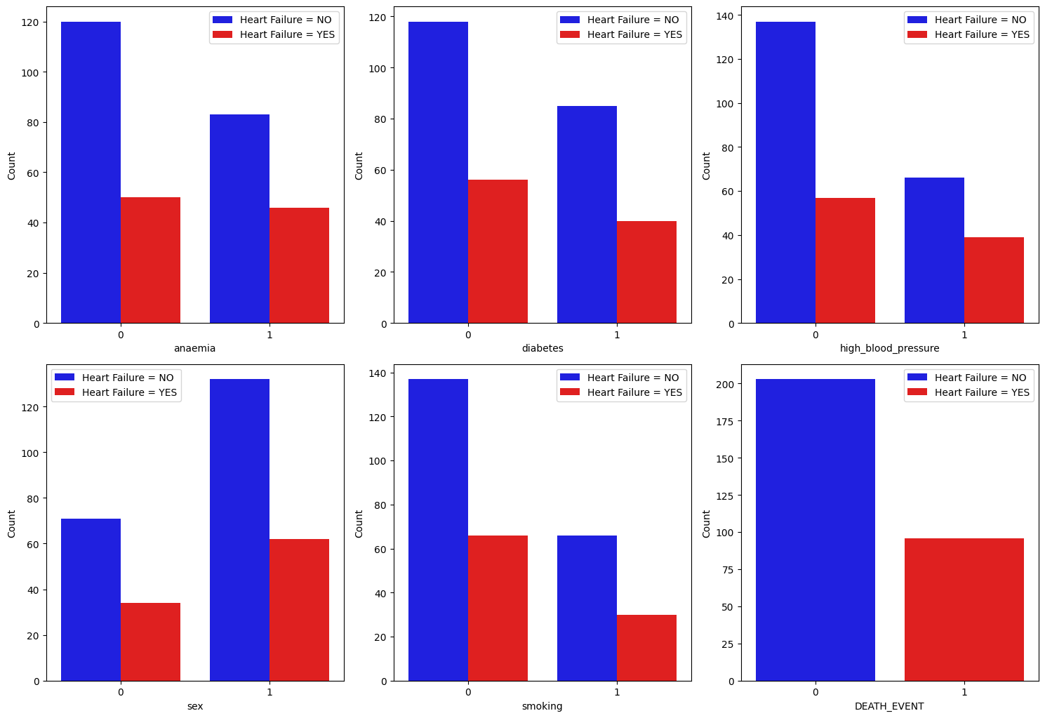
Data Analysis: Categorical Features
High blood pressure, anemia, diabetes, and smoking seem to be potential risk factors for heart failure.
Males appear to be more affected than females in this dataset.

Slide 14
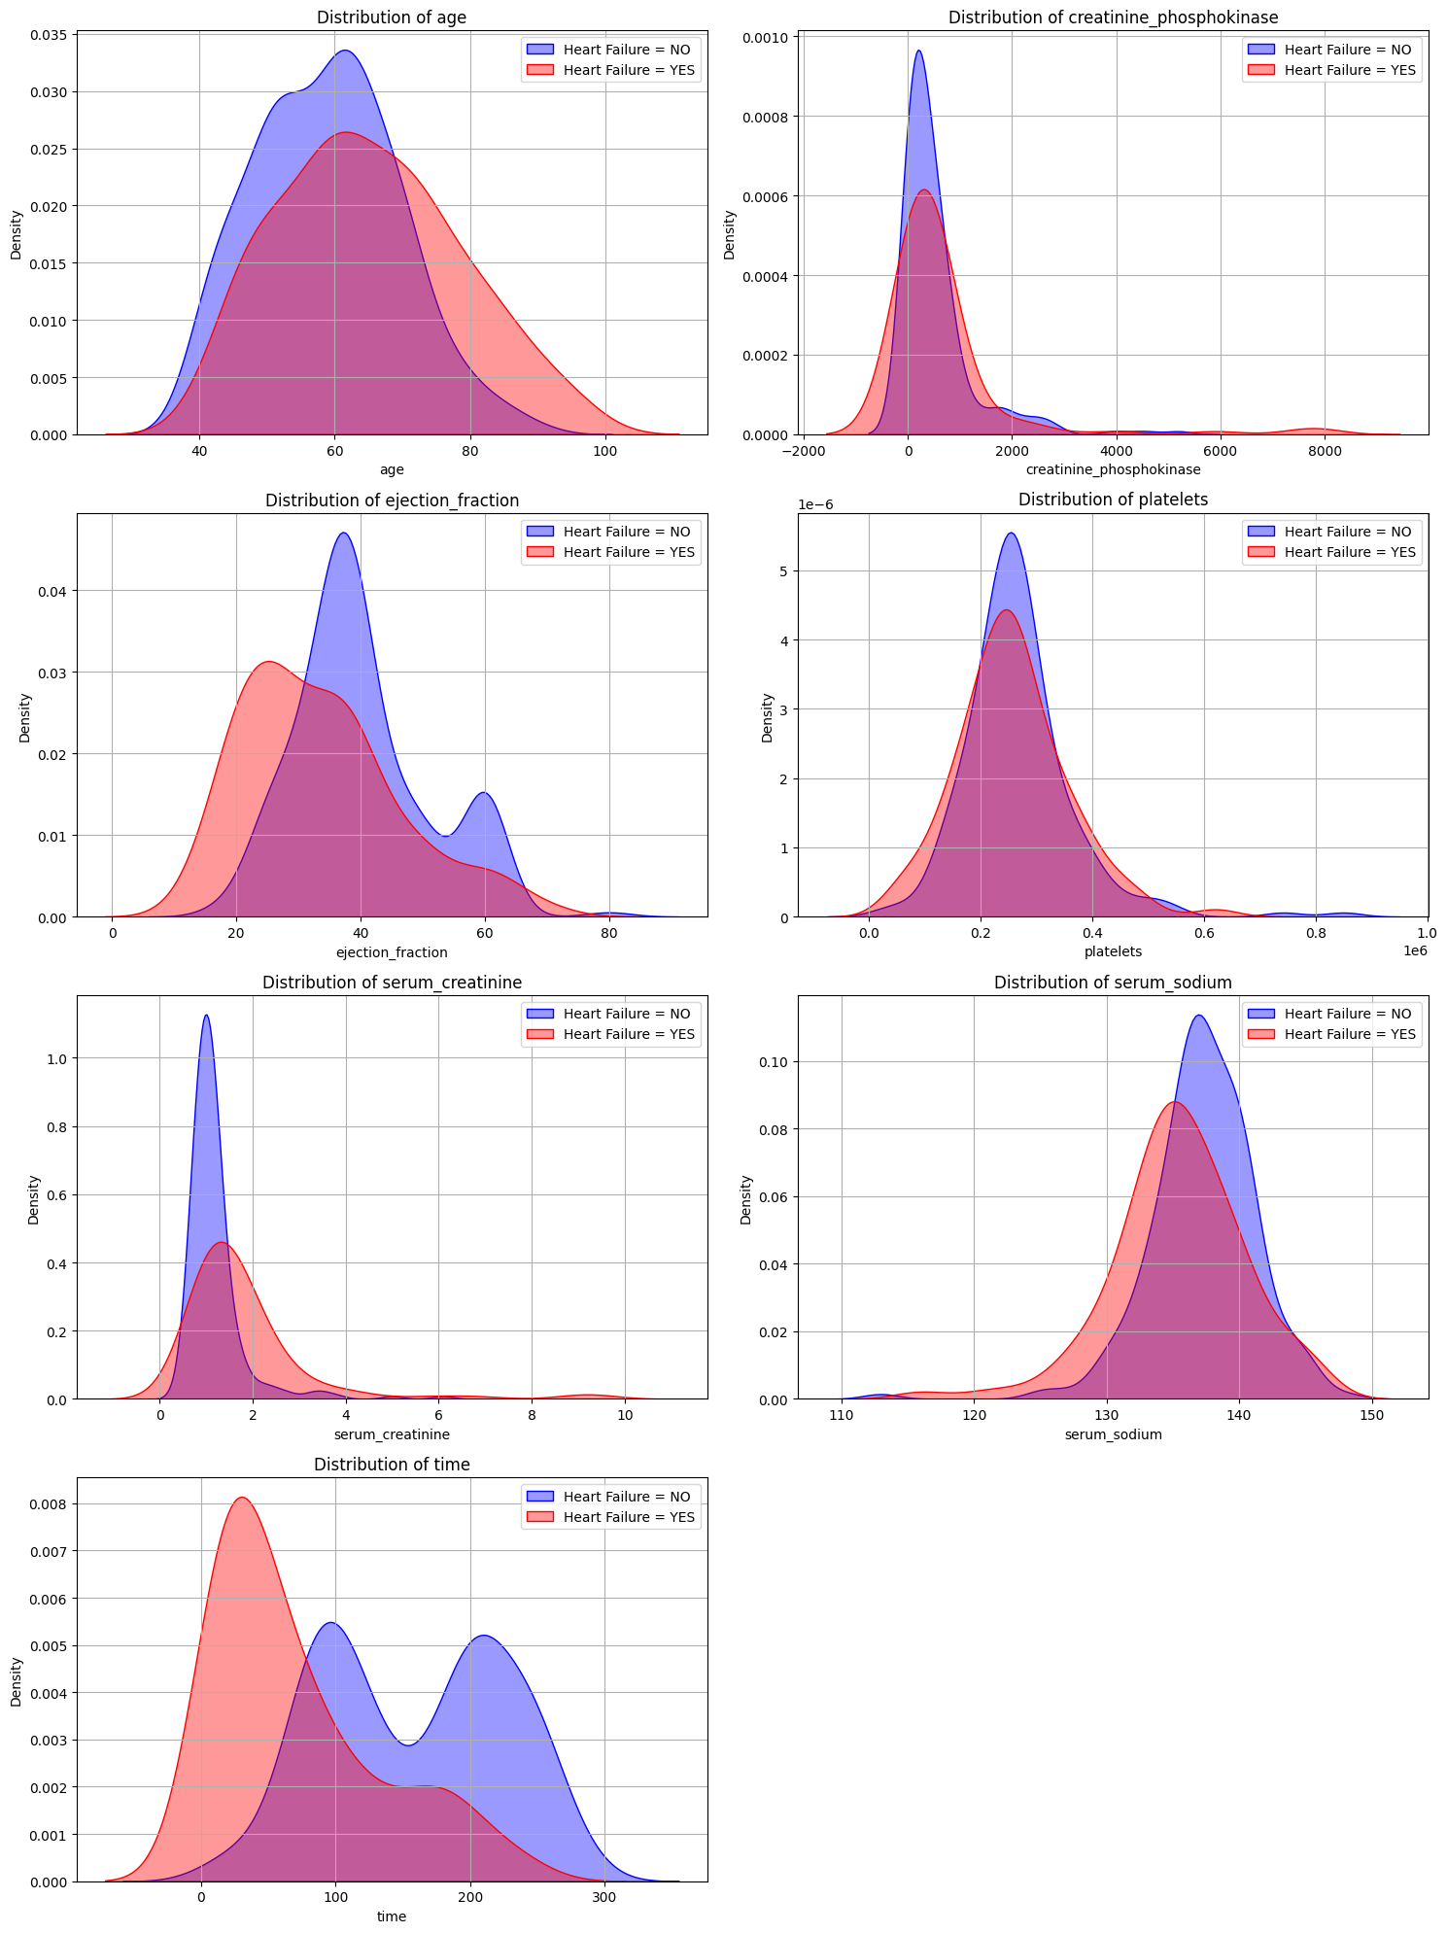
Data Analysis: Continous Features
Age, ejection fraction, serum creatinine, and serum sodium appear to be key differentiators between heart failure and non-heart failure patients.
Platelet count does not show a clear separation, meaning it might not be a strong predictor.
Higher creatinine and lower sodium levels suggest potential kidney involvement in heart failure.
Time differences indicate that heart failure patients might have shorter survival or follow-up durations.

Slide 15
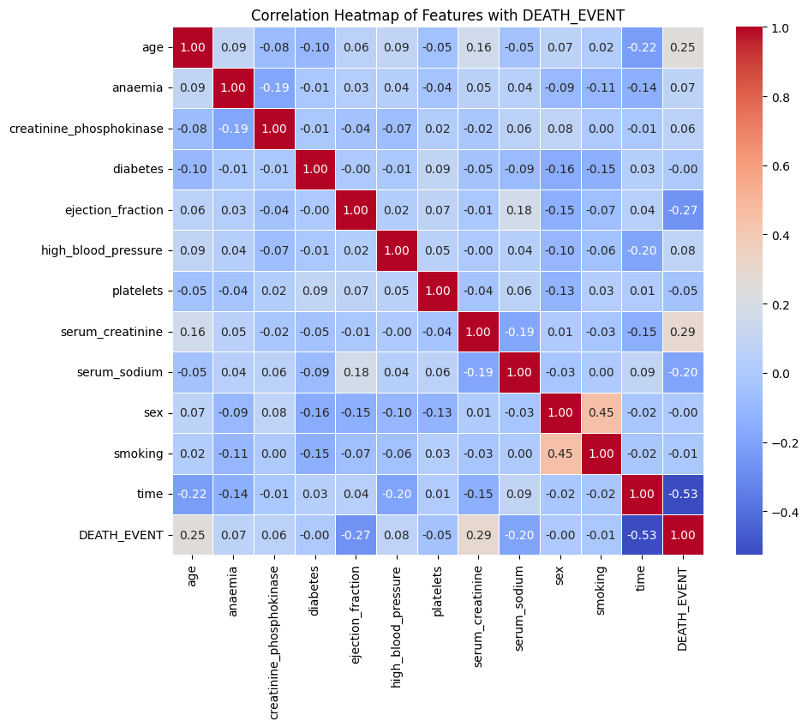
Data Analysis: Correlation
Age, ejection fraction, serum creatinine, and serum sodium appear to be key differentiators between heart failure and non-heart failure patients.
Platelet count does not show a clear separation, meaning it might not be a strong predictor.
Higher creatinine and lower sodium levels suggest potential kidney involvement in heart failure.
Time differences indicate that heart failure patients might have shorter survival or follow-up durations.

Slide 16
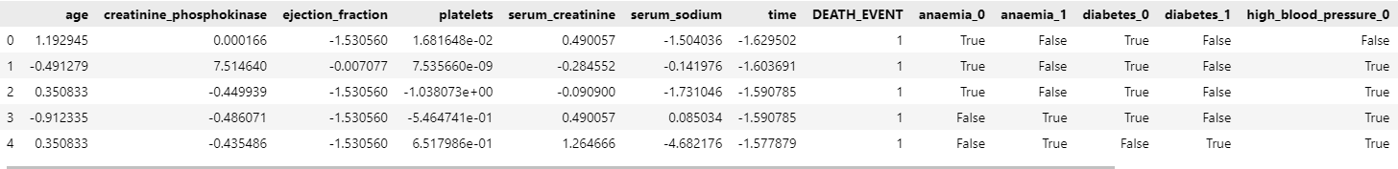
Data Analysis: Feature Engineering

Slide 17
Machine Learning Analysis: Classification models
Supervised Machine Learning: Classification
Heart Failure Analysis Prediction

Slide 18
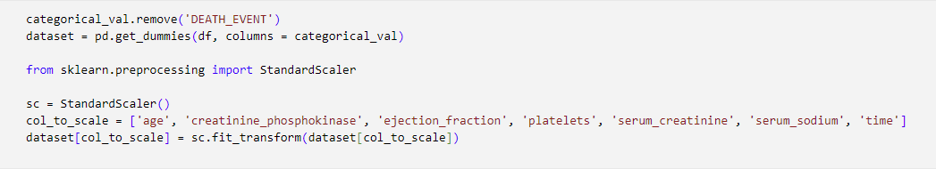
Logistic Regression
Defining independent and dependent attributes in training and test sets
Setting up a standard scaler for the features and analyzing it thereafter

Slide 19
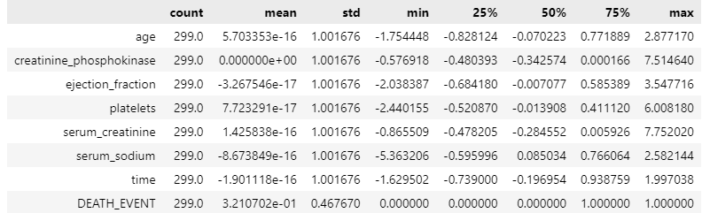
Logistic Regression

Slide 20
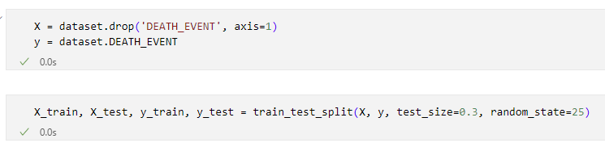
Logistic Regression
Splitting variables into training and test sets

Slide 21
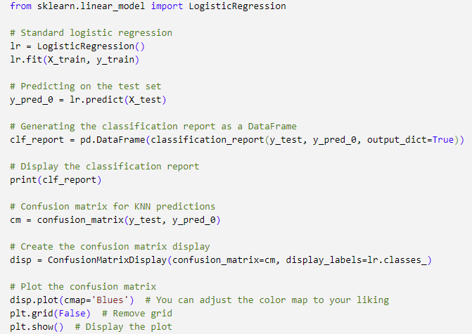
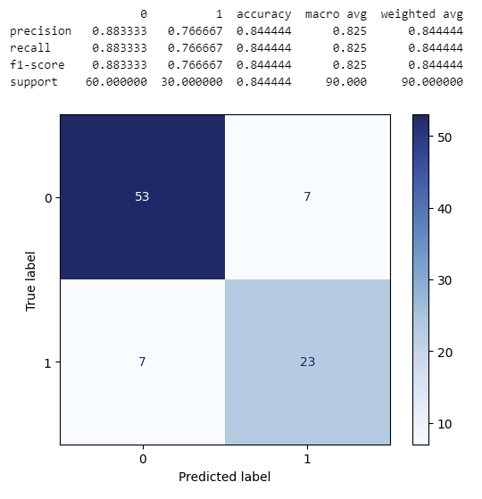
Logistic Regression

Slide 22
KNN Classifier
Supervised Machine Learning: Classification
Heart Failure Analysis Prediction

Slide 23
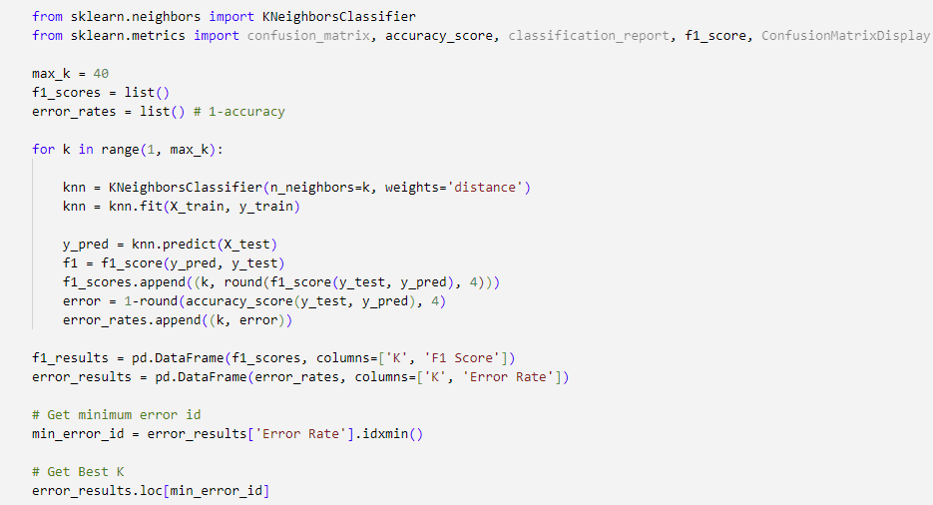

KNN Classifier

Slide 24
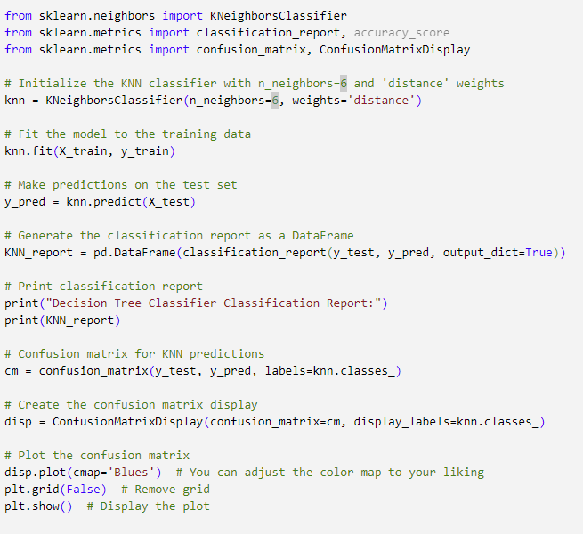
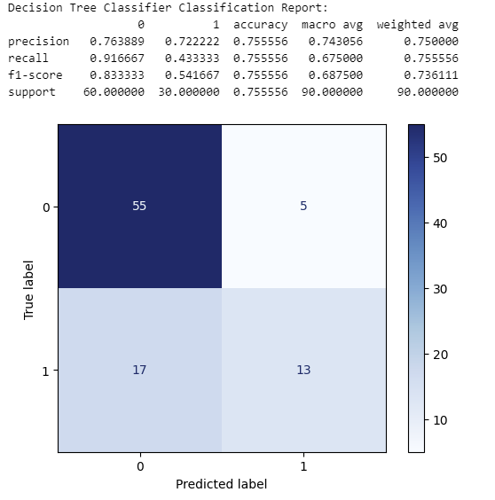
KNN Classifier

Slide 25
SVM Classifier
Supervised Machine Learning: Classification
Heart Failure Analysis Prediction

Slide 26
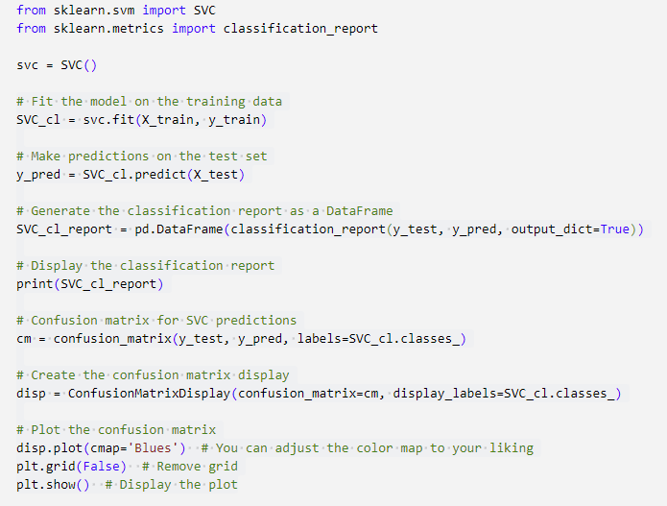
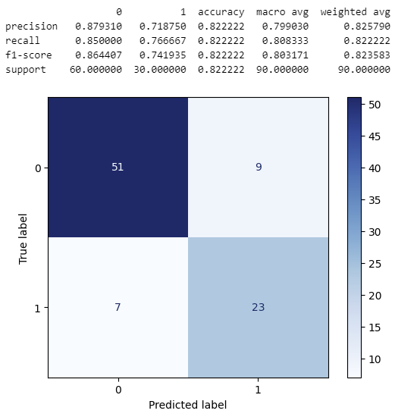
SVM Classifier

Slide 27
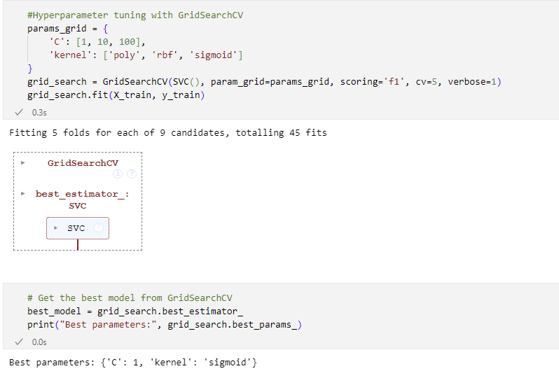
SVM Classifier: Grid Search

Slide 28
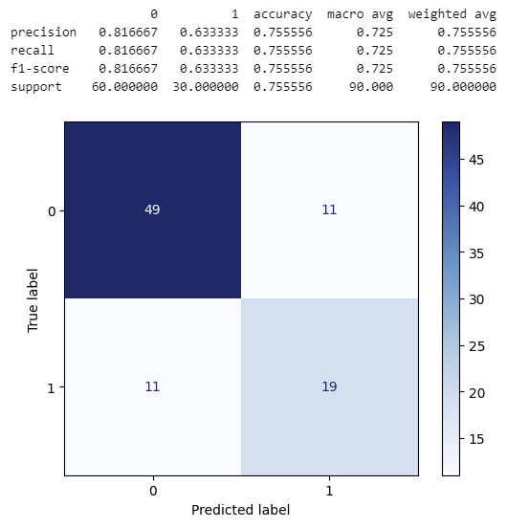
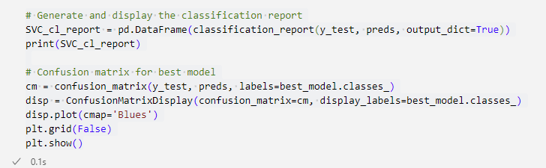
SVM Classifier: Grid Search

Slide 29
Decision Tree Classifier
Supervised Machine Learning: Classification
Heart Failure Analysis Prediction

Slide 30
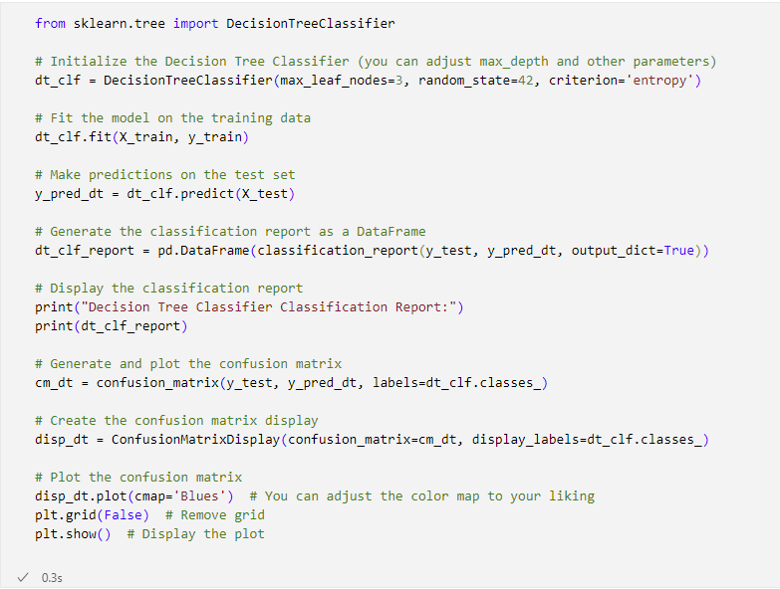
Decision Tree Classifier

Slide 31
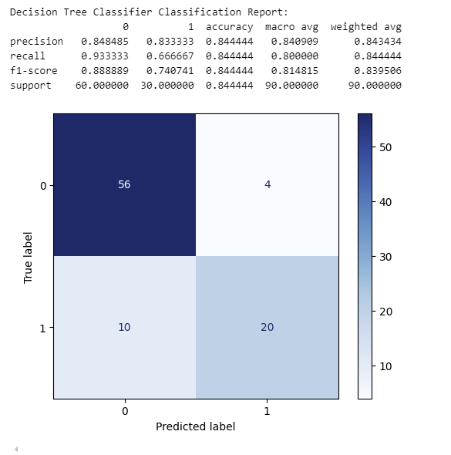
Decision Tree Classifier

Slide 32
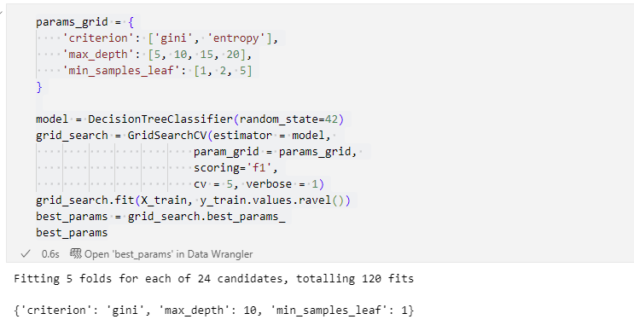
Decision Tree Classifier: Grid Search

Slide 33
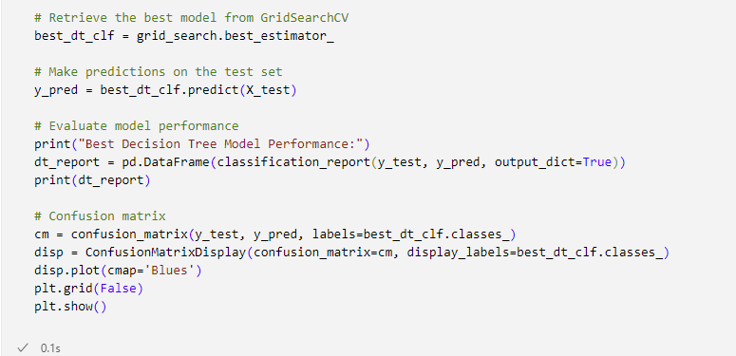
Decision Tree Classifier: Grid Search

Slide 34
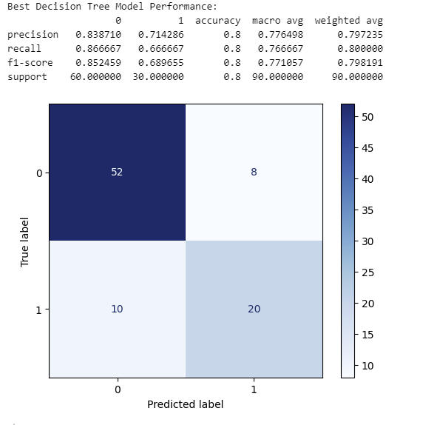
Decision Tree Classifier: Grid Seach

Slide 35

Model Comparison
While both models have similar accuracy, the logistic regression model demonstrates a better balance in performance across both classes and a lower number of false negatives, making it slightly more suitable for this specific scenario :
Logistic Model
Decision Tree
SVM
KNN

Slide 36
Conclusion
Supervised Machine Learning: Classification
Heart Failure Analysis Prediction

Slide 37
Conclusion
Interpretability: Logistic regression is often easier to interpret, as the coefficients associated with the features provide insights into their importance. Decision trees can also be interpreted but might become complex with many levels.
Model Complexity: Decision trees can be more prone to overfitting, especially if not pruned properly.1 Logistic regression is generally simpler and less likely to overfit.
Dataset Characteristics: The performance of these models can vary depending on the specific dataset and its characteristics (e.g., size, feature types, class balance).

Slide 38
Thank you
IBM Machine Learning Professional Certificate
Supervised Machine Learning: Classification
Shaula Marquez

